Slide 1
Trend Management System
Select ICT Technical Proposal

Slide 2
Select ICT Overview
Trend Management System

Slide 3



Who we are?
Select ICT was founded 2010 in Egypt, expanding to many countries in the Middle East
We are a System Integrator (SI) providing full solutions to our customers
We are specialized in providing tailored solutions with business consultation
Our main mission statement is that we work with our customers as partners, believing that their success is our success
Main Business Sectors
Telecommunication
Pharmaceutical
Retail
Brokerage
Manufacturing
Infrastructure Solutions
Software
Solutions
Online
Services

Slide 4















Our Partners

Slide 5






























Some of Our Customers

Slide 6
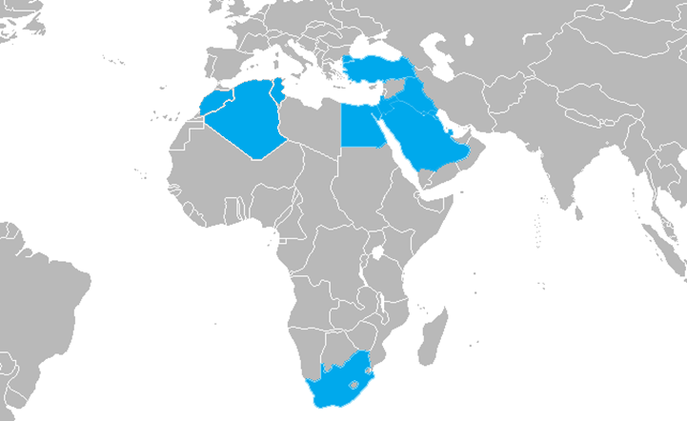
Our Expansion (Customers)
Egypt
Saudi Arabia
Turkey
Gulf
UAE
Kuwait
Oman
Bahrain
Near East
Jordon
Lebanon
Iraq
South Africa
North Africa
Morocco
Algeria
Tunisia

Slide 7
Our Solutions
Trend Management System

Slide 8






Software Solutions
Customizable Solutions
Web Portals
We create solutions for our customers based on their specific requirements that supports them to enhance the performance
Online solutions to automate our customers for their workflows and can interface with end customers
Mobile Applications
Analytics Solutions
Mobile applications with its APIs and backend portals to provide mobility to out customers and make the data reachable everywhere
Tools for discovery, interpretation, and displaying of meaningful patterns in data relies on the simultaneous application of statistics, computer programming.
Business Solution
Big Data Solutions
ERP, CRM, IMS, e-Commerce solutions implementation to wide range of well know solutions from multiple vendors.
Extremely large data sets that is analyzed computationally to reveal patterns, trends, and associations, especially relating to human behavior and interactions.

Slide 9








Infrastructure Solutions
Performance Optimization Solutions
End-user Computing Solutions
Datacenter Consolidation Solutions
Hardware Platforms Solutions
Storage Solutions
Backup Solutions
Cabling & Passive Implementation
Security Solutions

Slide 10






Online Services
Social Media Analytics using IBM platforms
Creative Concept Generation Relevant to Audience and Region
Content Creation and Management
Social Media Pages Management and Boosting
Lead Generation and Traffic Conversion
Product Launches and Campaign Management

Slide 11
Our Development Team
Software Division
Development Team
Quality Control Team
UI/UX Team
Business Team
Business Analysts
Project Managers
Testers
Android Team
Designers
iOS Team
Web & Integration Team
UI/UX Experts
QC Experts

Slide 12
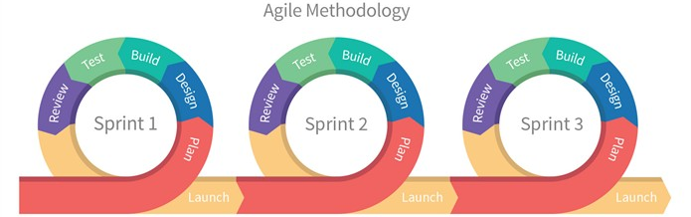
Development Process
We use Agile Methodology for software development
Development is done in Sprints each of 2-3 weeks
Customer is involved in the end of each Sprint to review the finished work and prepare for the next one
Each Sprint consists of 5 steps
Plan
Design
Build
Test
Review

Slide 13
Proposed Solution Scope
Trend Management System

Slide 14
Solution Summary & Goals
Summary
Solution we propose is a system that allows the following:
Lead Management
Projects Management
Workflow Management
Client Management
Contractors Management
Users Management
Bank Integration
Analytics (Dashboards & Reports)
Goals
Solution will provide:
Business Development, Sales and Presales Management
Full project control including cost management (actual, planned and predicted) and delivery management
Process/workflow automation with forums
Online visibility for all business aspects all time
Dynamic dashboards and reports to ensure detailed flexible analytics

Slide 15
Project Types and Stages
Turn Key
Refurbishment
Tenders
Lead
Appointment
Onsite
Close out
Filing
New opportunity initial activity
Risk work
Presales and negotiation activities
Contracting and planning
Project development and execution
Project delivery and handover
Closing and archiving the project finished

Slide 16
Lead
Lead is a new sales opportunity with existing or new customer
Only seen by owner and directors
Feedback of meeting define the qualification of the opportunity
If successful then proceed to risk work and open client project that will contain all data related till project closure
If not successful it will be archived as a non qualified opportunity (Filing)
Leads report to show all reports with multiple filters options
Lead Information Template
Meeting
Business Development Assignment
Feedback
Decision (Risk work or Filing)

Slide 17
Risk work
Presales activities to propose and present the solution to client
Attach all files created in proposal to client project attachments section
Feedback of presentation define if won or lost
If successful then proceed to appointment
If not successful it will be archived as lost (Filing)
Notifications will be sent based on schedules and updates
Client Brief Template
Presentation/Proposal Planned Timeline
Proposal Preparation
Drawings
3Ds
Cost
Presentation
Presentation/Proposal Feedback
Decision (Appointment or Filing)

Slide 18
Appointment
Appointment is contracting and planning part for the project
Attach all files related (on-going activity till the end of the project) including purchases, payments, P&L …etc
Project plan and timelines
Customer approval is needed to proceed
If successful then proceed to on site
If not successful it will be archived as lost (Filing)
Notifications will be sent based on schedules and updates for finance and different teams
Scan signed contract
Upload Agreed and signed budget
Invoicing structure and schedules
Project Planning and timeline
Decision (On site or Filing)
Customer approval

Slide 19
Onsite
Onsite is execution part of the project
Attach all files related (on-going activity till the end of the project) including purchases, payments, P&L …etc
All purchase requests, payments and variations orders are added to assigned budget
Monitor project actual cost vs planned cost, updating P&L analysis
Notifications will be sent based on schedules and updates to project management as well involved teams
Site mobilization
Progress report
Purchase request
Payment request
Program updates
Quality Control
Variations order requests

Slide 20
Close out
Close out is the finalizing stage of the project including delivery, handover, defining snags and ensure client satisfaction
Update client project information and documents
Define all snags and pending/remaining activities with schedules
Closure report with full project details
Notifications will be sent based on schedules and updates
Handover report
Certificates & commissioning reports
Snag List (with schedules)
Client feedback
Reference letter
Marketing confirmation
Project photoshoots

Slide 21
Filing
Filing and Archiving project with all its documents
Ensure all snag list is cleared
Schedule any activates related to business development
Schedule any activates related to customer care and satisfaction
Notifications to be sent to Business development and customer care based on defined schedule as well as predefined protocol (example: re-contact client after three years)
Filing project
Close snags
Schedule client re-contact (Business Development)
Schedule any post delivery activates (Customer care)
Final report

Slide 22




Solution Modules (1)
Lead Management
Projects Management
Client definition
Lead definition
Reports
Project details
Schedules and timelines
Budget, payments and changes
P&L analysis
Documents
Reports
Workflow Management
Client Management
Process management
Notifications
Updates
Decision taking actions
Reports
Client definition
Clients projects
Client history
Client analysis
Reports

Slide 23




Solution Modules (2)
Contractors Management
Users Management
Contractors/suppliers definition
Related projects purchase orders
Related projects payments
Reports
System users management
Roles management
User activities log
Access management
Data access
Modules access
Action privileges
Bank Integration
Analytics (Dashboards & Reports)
Integration with bank accounts
Uploading data
Reports
Online updated system
Dashboards
All Reports
Personalized
Reports access management

Slide 24
Solution User Roles
Designers Team
Project Management Team
Site Controllers Team
Financial Team
Marketing Manager
Business Development Team

Slide 25
Project Timeline
Phase 1
(4 Months)
Phase 2
(3 Months)
Preparation phase
(1 Month)
Detailed Scope
Project full plan
Resources allocation
Prioritization
Approvals
Lead Management
Bank Integration
Projects Management
Workflow Management
Client Management
Basic Users Management (Module and activity)
Basic Reports
Advanced Analytics
Advanced Users Management (Data access)
Contractors Management

Slide 26
Project Team
Scrum Master
Web Developer
Quality Engineer/Tester
Product Owner
Team Lead
Responsible for process implementation and ensuring agile implementation
Represents the customer inside our team, will be responsible for all communication with the customer as well as requirements details from the business prospective
Responsible for testing and quality review after each feature is developed
Responsible for APIs development for mobile application as well as the backend development
Designer (UX/UI)
Responsible for developing wireframes, turning them into designs for all screen as well as providing all needed material for the development team
Senior Developer with Business and Technical Background, with average 6-8 years experience

Slide 27
Thank You
Trend Management System

